Slide 1
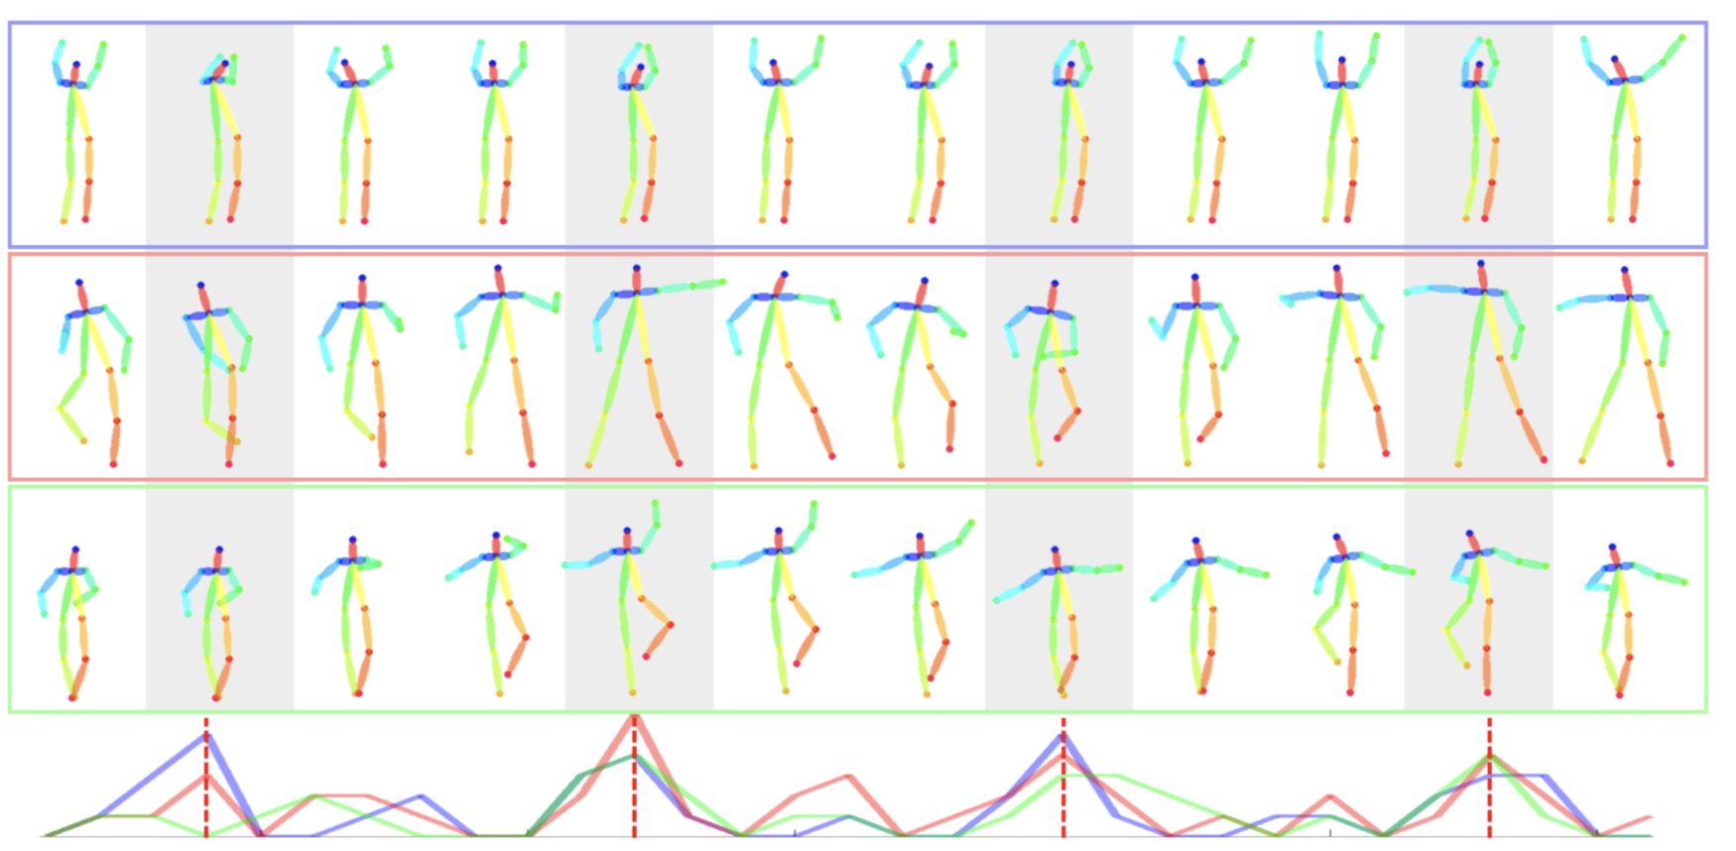
Dancing to Music in 3D
Han Yan, Weiyu Du
CIS 565 Final Project Pitch

Slide 2
Overview
Background
Dancing to music is an instinctive move by humans. However, learning to model the music-to-dance generation process is a challenging problem.
Impact
Potential to assist and expand content creation in arts and sports
Better understanding of cross-model synthesis
Motivation
Existing work tackles the problem in 2D joint space, due to constraint on training data collection. However, human body moves in the 3D space. Learning only 2D movements not only yields partial understanding of human dynamics, but also hurts the generation in terms of realism and aesthetics.
[1] Lee, H.Y., Yang, X., Liu, M.Y., Wang, T.C., Lu, Y.D., Yang, M.H., Kautz, J.: Dancing to music. In: NeurIPS (2019)
[2] Tang, T., Mao, H., Jia, J.: Anidance: Real-time dance motion synthesize to the song. In: 2018 ACM Multimedia Conference on Multimedia Conference. pp. 1237–1239. ACM (2018)
[3] Tang, T., Jia, J., Mao, H.: Dance with melody: An lstm-autoencoder approach to music-oriented dance synthesis. In: 2018 ACM Multimedia Conference on Multi-media Conference. pp. 1598–1606. ACM (2018)

Slide 3
Schedule
Milestone 1 Obtaining 3D training data using off-the-shelf models to reconstruct 3D joints from dance videos.
Milestone 2 Implement music-to-generation model in 3D joint space with PyTorch based on Lee et al. (Neurips 2019). [1]
Milestone 3 Model training and performance analysis.
Final Prepare for final presentation and demo.
[1] Lee, H.Y., Yang, X., Liu, M.Y., Wang, T.C., Lu, Y.D., Yang, M.H., Kautz, J.: Dancing to music. In: NeurIPS (2019)

Slide 4
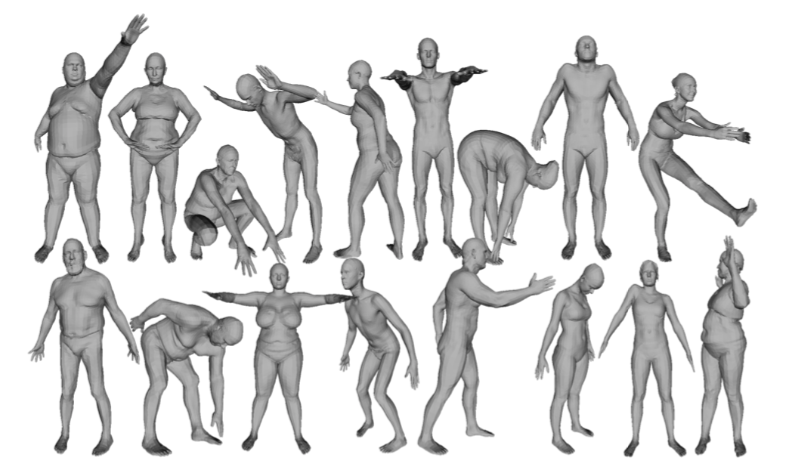
APIs, Platforms
PyTorch [1]: Machine learning library that supports GPU tensor operations
SMPL [2]: Skinned Multi-Person Linear Model
Possible third-party codebase for off-the-shelf pose reconstruction from video [3]: https://github.com/akanazawa/human_dynamics
[1] Paszke, A., Gross, S., Massa, F., Lerer, A., Bradbury, J., Chanan, G., Killeen, T.,Lin, Z., Gimelshein, N., Antiga, L., Desmaison, A., Kopf, A., Yang, E., DeVito, Z.,Raison, M., Tejani, A., Chilamkurthy, S., Steiner, B., Fang, L., Bai, J., Chintala, S.:Pytorch: An imperative style, high-performance deep learning library. In: Wallach,H., Larochelle, H., Beygelzimer, A., d'Alch ́e-Buc, F., Fox, E., Garnett, R. (eds.) Advances in Neural Information Processing Systems 32, pp. 8024–8035. Curran Associates, Inc. (2019)
[2] Loper, M., Mahmood, N., Romero, J., Pons-Moll, G., Black, M.J.: SMPL: A skinned multi-person linear model. ACM Trans. Graphics (Proc. SIGGRAPH Asia) 34(6), 248:1–248:16 (Oct 2015)
[3] Kanazawa, A., Zhang, J.Y., Felsen, P., Malik, J.: Learning 3d human dynamics
from video. In: Computer Vision and Pattern Regognition (CVPR) (2019)

